Slide 1
Basic Electrical Technology [ELE 1051]
Chapter 3 - Single Phase AC Circuits
(3.3)

Slide 2
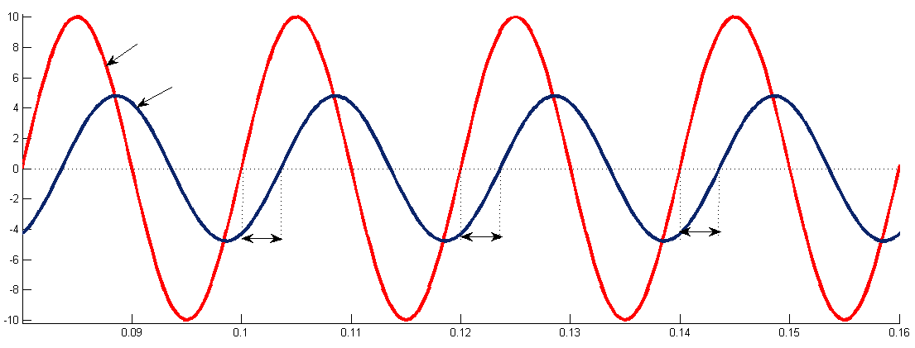











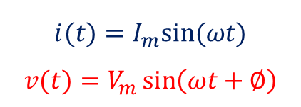











RL circuit analysis
$$L$$
Graphical Representation
$$i(t)$$
$$R$$
$$v(t)$$
$$V_{R}$$
$$V_{L}$$
$$i(t)$$
$$v(t)$$
f = 50 Hz
Amplitude →
$$Let \overline{I} be along the reference$$
$$∅$$
$$∅$$
$$∅$$
$$\overline{V_{R}}=\overline{I}R$$
Time →
$$\overline{V_{L}}=j\overline{I}X_{L}$$
$$\overline{V}=\overline{V_{R}}+\overline{V_{L}}=|V|∠∅$$
Phasor Representation
Impedance
$$\frac{\overline{V}}{\overline{I}}=\frac{\overline{I}(R+jX_{L})}{\overline{I}}=R+jX_{L}=|Z|∠∅$$
$$V_{rms}$$
Mathematical Representation
$$V_{L}$$
$$i(t)=I_{m}sin⁡(ωt)$$
$$v(t)=V_{m}\sin\left(ωt+∅\right)$$
$$Z −Impedance of the circuit$$
$$∴R=|Z|\cos{∅{ X}_{L}=|Z|\sin{∅}}$$
$$∅$$
Ref.
$$\left|Z\right|=\sqrt{R^{2}+X_{L}^{2}}$$
$$∅=\tan^{−1}{\frac{X_{L}}{R}}$$
$$∅ −Phase Angle$$
$$V_{R}$$
$$I_{rms}$$

Slide 3








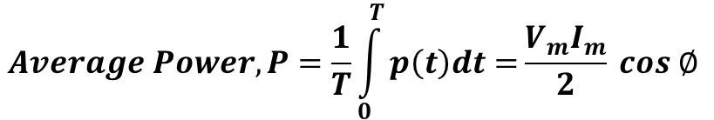



Power associated - RL circuit
$$P\left(t\right)$$
P_{R} (t)→ Active Power
P_{L} (t)→ Reactive Power
P (t) → Apparent Power
$$v\left(t\right)$$
Amplitude
$$P_{R}\left(t\right)$$
$$i\left(t\right)$$
φ
0.02
0.04
0.06
Time(sec)
$$P_{L}\left(t\right)$$
Instantaneous power,
$$Average Power, P=\frac{1}{T}\int_{0}^{T}{p\left(t\right)dt=}\frac{V_{m}I_{m}}{2} cos ∅$$
$$p\left(t\right)=v\left(t\right).i(t)$$
$$=V_{m}I_{m}\sin{ωt}.\sin{(ωt+}∅)$$
$$=V_{rms}I_{rms}[\cos{∅}−\cos{(2ωt+∅)]}$$
$$P_{avg}=V_{rms}I_{rms}\cos{∅}$$
$$\cos{∅} is called the Power Factor$$

Slide 4
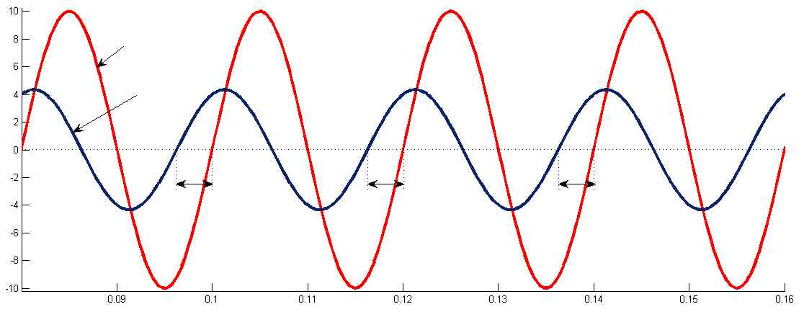
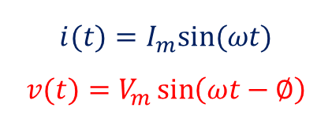















RC circuit analysis
C
Graphical Representation
$$i(t)$$
$$R$$
$$v(t)$$
$$v(t)$$
$$i(t)$$
f = 50 Hz
Amplitude →
$$∅$$
$$∅$$
$$∅$$
$$Let \overline{I} be along the reference$$
$$\overline{V_{R}}=\overline{I}R$$
Time →
$$\overline{V_{C}}=−j\overline{I}X_{C}$$
Impedance
$$\overline{V}=\overline{V_{R}}+\overline{V_{C}}=\left|V\right|∠−∅$$
Phasor Representation
$$\frac{\overline{V}}{\overline{I}}=\frac{\overline{I}(R−jX_{C})}{\overline{I}}=R−jX_{C}=\left|Z\right|∠−∅$$
Mathematical Representation
$$∅$$
$$V_{R}$$
$$I_{rms}$$
Ref.
$$i(t)=I_{m}sin⁡(ωt)$$
$$v(t)=V_{m}\sin\left(ωt−∅\right)$$
$$Z −Impedance of the circuit$$
$$∴R=|Z|\cos{∅{ X}_{C}=|Z|\sin{∅}}$$
$$V_{C}$$
$$V_{rms}$$
$$\left|Z\right|=\sqrt{R^{2}+X_{C}^{2}}$$
$$∅=\tan^{−1}{\frac{X_{C}}{R}}$$
$$∅ −Phase Angle$$

Slide 5
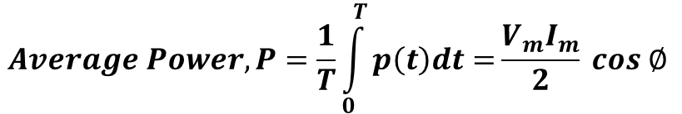









Power associated - RC circuit
$$P\left(t\right)$$
P_{R} (t)→ Active Power
P_{L} (t)→ Reactive Power
P (t)→ Apparent Power
Amplitude
$$v\left(t\right)$$
$$P_{R}\left(t\right)$$
$$P_{L}\left(t\right)$$
$$i\left(t\right)$$
φ
0.02
0.04
0.06
Time(sec)
Instantaneous power,
$$Average Power, P=\frac{1}{T}\int_{0}^{T}{p\left(t\right)dt=}\frac{V_{m}I_{m}}{2} cos ∅$$
$$p\left(t\right)=v\left(t\right).i(t)$$
$$=V_{m}I_{m}\sin{ωt}.\sin{(ωt−}∅)$$
$$P_{avg}=V_{rms}I_{rms}\cos{∅}$$
$$=V_{rms}I_{rms}[\cos{∅}−\cos{(2ωt−∅)]}$$

Slide 6



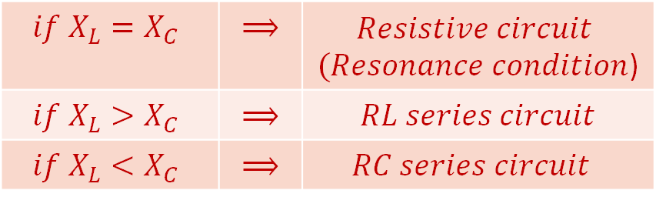


RLC circuit
L
C
$$i(t)$$
$$R$$
$$v(t)$$
f = 50 Hz
$$Let i\left(t\right) be the reference$$
$$Impedance, Z=R+j(X_{L}\sim X_{c})$$
$$if X_{L}=X_{C}$$ | $$⟹$$ | $$Resistive circuit$$ $(Resonance condition$)
$$if X_{L}>X_{C}$$ | $$⟹$$ | $RL series circuit$
$$if X_{L}<X_{C}$$ | $$⟹$$ | $$RC series circuit$$

Slide 7

Illustration 1
A resistance of 50$Ω$ is connected in series with an inductance of 200mH and capacitance of 101.321$μ$F across a 230V, 50 Hz, single phase AC supply. Obtain,
Impedance of the circuit
Current drawn
Power factor
Power consumed
Phasor diagram
𝑍 =𝟓𝟎+𝒋𝟑𝟏.𝟒𝟏𝟓𝟔𝜴 =𝟓𝟗.𝟎𝟓𝟎∠𝟑𝟐.𝟏𝟒° 𝜴
𝐼 =𝟑.𝟖𝟗𝟖∠−𝟑𝟐.𝟏𝟒°𝑨
𝑃𝐹 = 𝟎.𝟖𝟒𝟔 𝒍𝒂𝒈
P = 𝟕𝟓𝟗.𝟏𝟓𝑾
V
V_{L}
50$Ω$
101.321$μ$F
200mH
32.14º
230V, 50 Hz
V_{R}
I
V_{C}

Slide 8
Illustration 2
The circuit shown below has a source of 230V, 50 Hz. If the current through 0.05H inductor is 3.5 ∠-80 A, find the value of ‘R’ and ‘C’.
R = 23.58 Ω
C = 0.104 mF
Notes:
Parker Smith’s 500 solutions of problems in electrical engineering – solved by V. C. Natesan
Page No. 192, Problem 6.75

Slide 9

Thank You!

